Slide 1


Test Approaches on
DRIVER
Image Placeholder
Rana Tabassum| 29-September-2023

Slide 2
DRIVER
Project Summary-
DRIVER (Data for Road Incident Visualization, Evaluation and Reporting), a software that collects, analyses and reports data related to road incidents, intended for use by the Dhaka Metropolitan Police (DMP)
Deliverables:
Test Estimation
Test Plan
Test Case preparation
Test case execution
QA Report
Bug Report
Link: Project Deliverables

Slide 3
DRIVER
Test Estimation
Factors Considered:
Project scope
Requirements
Coverage of the Entire System
Assure highest quality
Test estimation of DRIVER:
Total Estimated Test Cases |  | 110.00
Estimated time (in man days) |  | 3.44
Link: Test Estimation

Slide 4
DRIVER
Test Plan in a brief-
Features to be Tested |  | Login Dashboard My Account Manage Duplicate Records Map Record List Add a record
Features not to be Tested |  | Non-Functional Testing User Acceptance Testing Retesting Scope Testing
Key covered area:
Test Objectives
Test Strategy
Schedule
Risk and Contingencies
Test Environment
Features to be tested
Features not to be tested
And some more areas were covered
Link: Test Plan

Slide 5
DRIVER
Test case Preparation and area of coverage
Modules |  | Login Dashboard My Account Manage Duplicate Records Map Record List Add a record
Test Coverage |  | Functional Testing System Testing GUI Testing
Functional Test Cases |  | 115.00
GUI Test Cases |  | 5.00
Link: Test Case Preparation

Slide 6
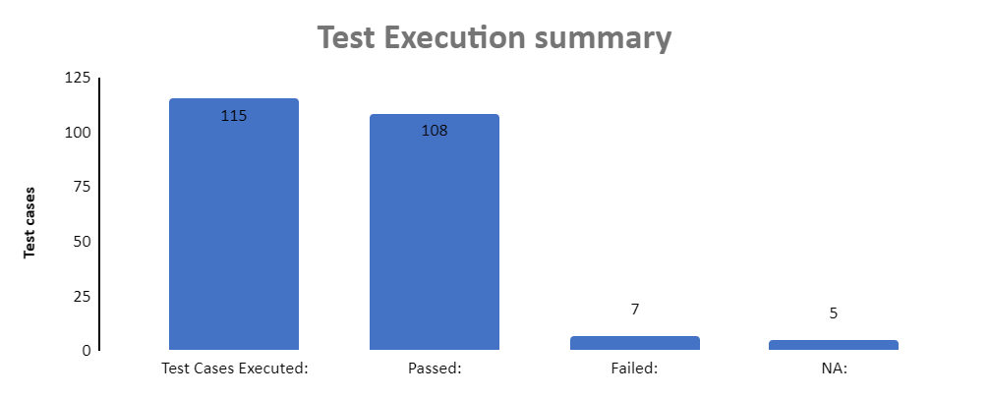
DRIVER
Test Execution and coverage
Link: Test Case Execution

Slide 7
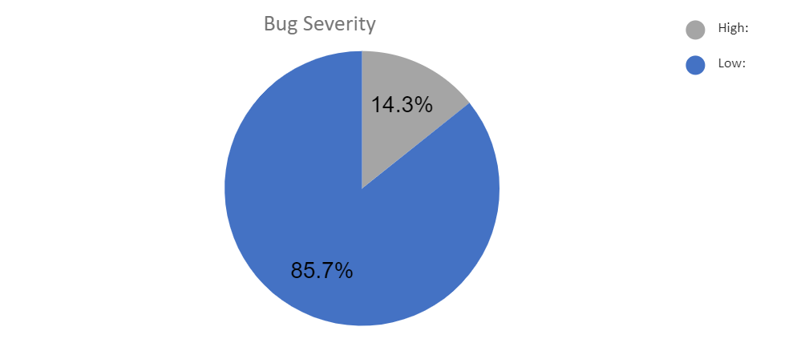
DRIVER
Bug Report
High Priority: 1
Low Priority: 6
Major Severity: 0
Minor Severity: 7
Link: Bug Report

Slide 8
Thank you

